Slide 1
MIS – PS Keep Your Time

Slide 2
Content

Slide 3
Team Members
Carla Machado - Quality Manager
David João - Quality Engineer
Filipe Brandão - Project Manager
João Girão - Test Manager
João Guilherme Martins - Client Manager
Mário Oliveira - Librarian Manager
Rui Ganhoto - Technical Manager & Risk Manager

Slide 4
Product Overview
João Martins

Slide 5
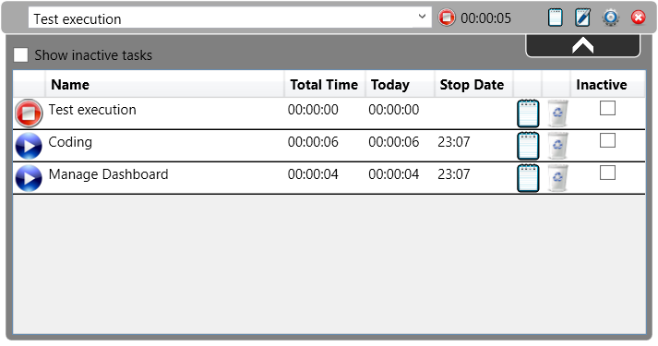
Product Overview

Slide 6
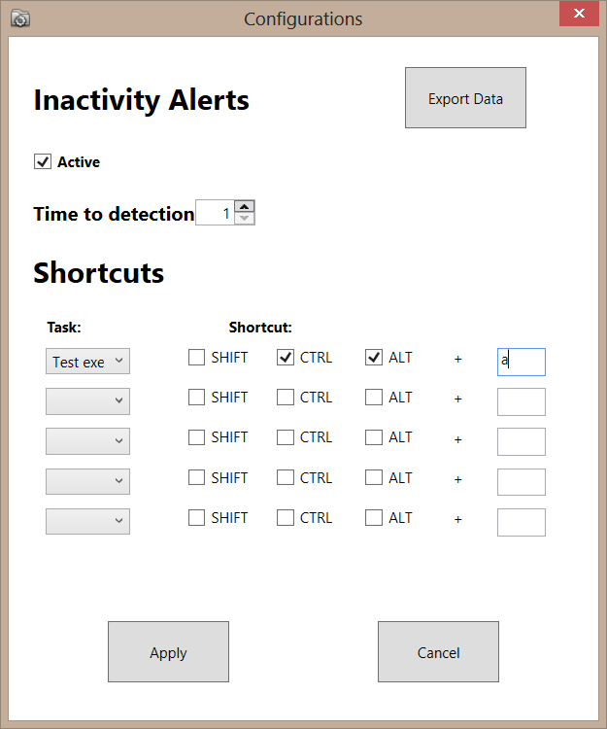
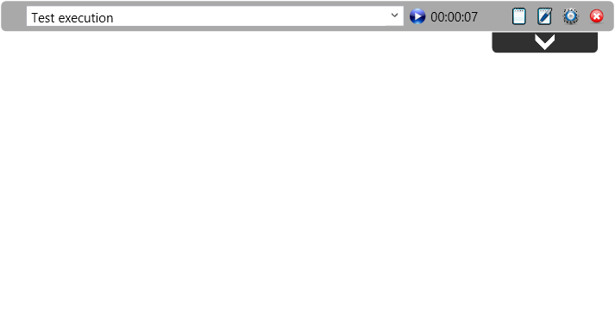
Product Overview

Slide 7
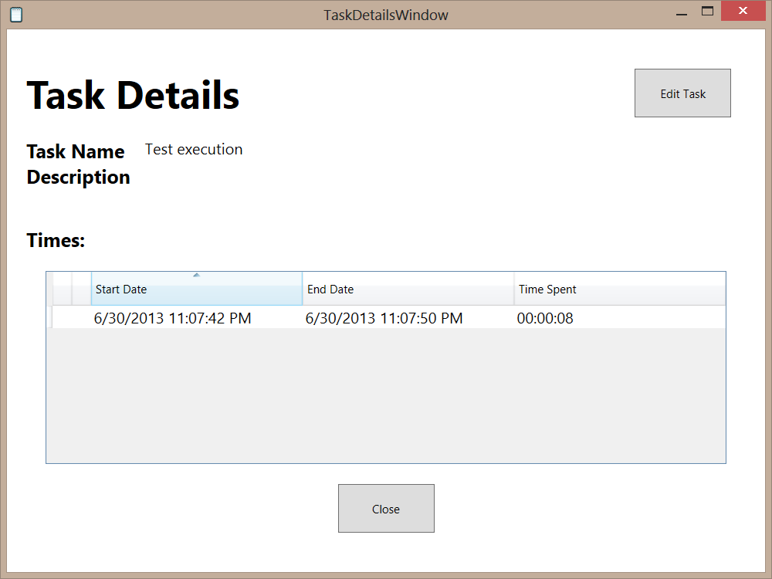
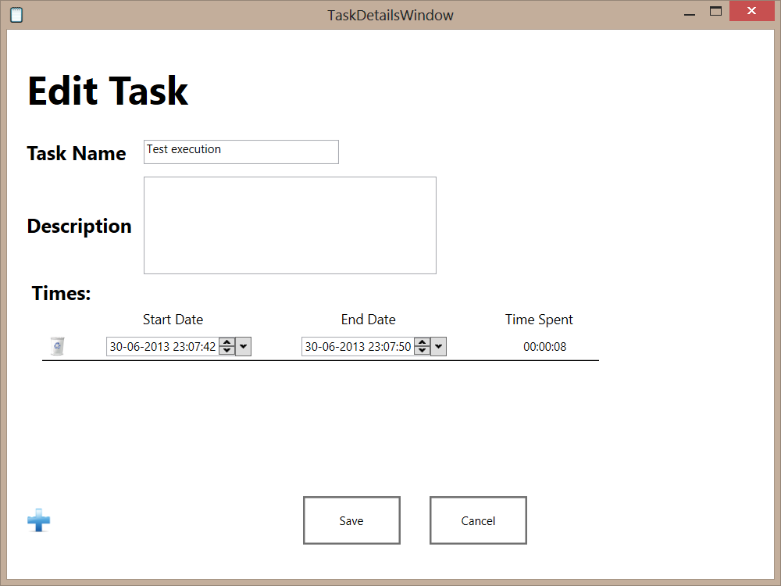
Product Overview

Slide 8
Project Managment
Filipe Brandão

Slide 9
Team Members
Carla Machado - Quality Manager
David João - Quality Engineer
Filipe Brandão - Project Manager
João Girão - Test Manager
João Guilherme Martins - Client Manager
Mário Oliveira - Librarian Manager
Rui Ganhoto - Technical Manager & Risk Manager

Slide 10
Product Overview
João Martins

Slide 12
Project Management
Filipe Brandão

Slide 13
Life Cycle
Requirements Analysis
Design & Construction
Verification & Validation

Slide 14
Milestones
Requirements Analysis
Design & Construction
Verification & Validation
KOM
8th April
SRS Review
6th May
Code Review
29th May
Acceptance
3rd June
Notes:
KickOff Meeting - 8th of April
The “Vision and Scope” and a project plan must be ready for presentation.
SRS Review – 6th of May
Marks the end of the production of the SRS (meaning it is ready for review). REPLANNING
Code Review – 29th of May -> 1 June
Marks the end of the coding phase. This means that the entire code and test plan must be ready.
Acceptance – 3rd of June
Marks the end of the acceptance phase and the whole project. This means that all the software is testes and corrected.

Slide 15
Deliverables
Vision and Scope
Software Development Plan
Quality Plan
Test Plan
Software Requirements Specification
Risk Plan
Software source code and binaries
Review Reports
Weekly Reports
Post-Mortem Report

Slide 16
Effort Estimation
Planning Poker was the technique used for effort estimation
Time during discussions was controlled
Work Breakdown Structure was built and discussed right before the estimation.
Two estimations were performed :
Before KOM
After “SRS Review” milestone
Notes:
Planning poker -> fast estimation -> fast discussion

Slide 17
Effort Estimation
Notes:
FONTE DOS VALORES : BREAKDOWN (EV)
Coding da estimation 2 já não inclui CI – MEETING
First estimation -> conding não tem android

Slide 18
Effort Estimation
Notes:
-39,25h horas de diferença entre o real e a estimação
FONTE DOS VALORES : BREAKDOWN (EV)

Slide 19
Real Effort
But according to the individual logs…
Notes:
Process Definition : Week 1 to Week 7 - expected 252h
Requirements: Week 8 to Week 10 -
Coding: Week 10 to 15 minus Testing
Testing : sum of testing tasks
Project expected:

Slide 20
Effort by Task Type
Task Type | Hours | Percent
Documentation | 230,75 | 41%
Meetings/Discussions | 75 | 14%
Coding | 65,25 | 12%
Research/Study | 58 | 10%
Revision | 46 | 8%
Requirements | 33,5 | 6%
Project/Quality/Risk Management | 22,5 | 4%
Repository Management | 14 | 3%
Testing | 7,25 | 1%
Bug fixing | 6,25 | 1%
Notes:
INCLUDES PROCESSES DEFINITION

Slide 21
Individual Effort
Notes:
Processes = 6 weeks
Project = 7 weeks

Slide 22
Weekly Individual Effort
Notes:
overwork

Slide 23
Management & Control
Software Development Plan
Centralized information
Microsoft Project for scheduling and allocation
Easier scheduling
What’s the next task at any given time
Earned Value Graph in Microsoft Excel for project control based on WBS tasks
Haven’t used its full potential.
Notes:
SDP -> plano inicial para KOM -> rework depois da KOM -> redefinição Milestones
Various problems on EV:
bad wbs -> TAREFAS NOVAS ---- QUAIS???
1 task -> 1 member
bugs when changed
Levou-nos a fazer um plano especial para a ultima semana

Slide 24
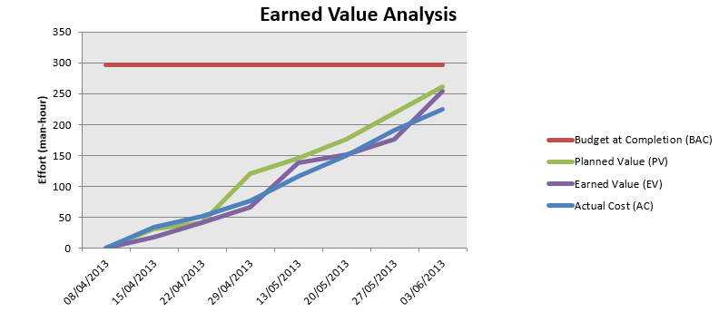
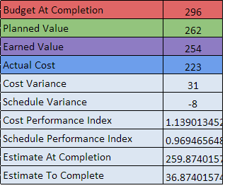
Management & Control
Earned Value Graph

Slide 25
Management & Control
Weekly reports
Weekly analysis
Individual logs
What was done, when it was done, how much did it cost.

Slide 26
Product
João Martins

Slide 28
Requirements
Number of Initial Requirements
66
Number of Delivered Requirements
64

Slide 29
Requirements
Requirements | Nº | Requirements Delivered | Requirements not Delivered
Functional | 53 | 51 | 2
Interface | 11 | 11 | 0
Performance | 2 | 2 | 0
Total | 66 | 64 | 2

Slide 30
Requirements conclusion
97% of the Requirements were delivered
Requirements not Delivered:
12CIT-003:ConfigureInactiveTime.Validate.False
1CT-004:Task.create.AutoComplete
Notes:
A tecnologia usada permite uma melhor validação contudo não permite mandar mensagem de erro porque a tecnologia resolve o erro sozinha
Funciona com o primeiro Caracter.Complicado de se fazer pois a tecnologia está optimizada para o primeiro caracter.

Slide 31
Document Managment
Mário Oliveira

Slide 32






Document repository

Slide 33
Document Repository
Google Code
Keep Your Time Project
Documentation
Meetings
Processes
Project Management
Templates
Test Results
Weekly Reports

Slide 34
Document Repository
Google Docs
Documents, Requirements, Tests and Review Measures
Dashboard
Logs

Slide 35
Document Repository
Google Sites
Project Information
Dashboard
Repository
Logs (link)
Project Documentation
Templates
Processes
Weekly Report
Meeting minutes
Kickoff Meeting
Code Repository (link)

Slide 36
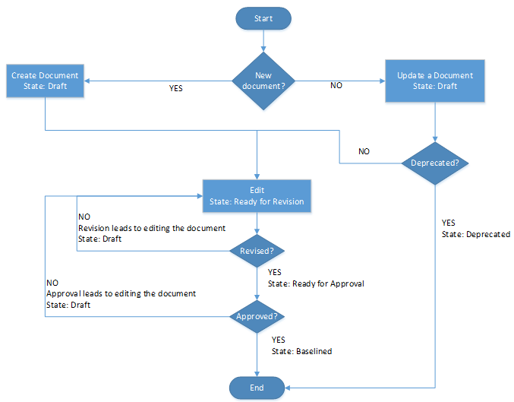
Document Repository
Documents state
Draft: 2
Ready for Revision: 0
Ready for Approval: 0
Baselined: 29
Deprecated: 0
Global Change Rate: 0,066

Slide 37
Project Quality
Carla Machado

Slide 38
Processes and Process Analysis
Document Management Process
It was followed in the majority of documents although some unconformities were detected
Not following correctly the hierarchy for the different roles
The process lacked flexibility in choosing the persons for the different roles
Project Assessment and Control Process
Project and risk control weren’t very accurate
Process wasn’t always exactly followed
Problems with some of the used tools

Slide 39
Processes and Process Analysis
Project Planning Process
Plan was updated
Redefinition of some concepts - milestones
Requirements Analysis Process
Major unconformity
changes were made that didn´t follow the change requirements process and documentation wasn’t updated

Slide 40
Processes and Process Analysis
Review Process
Major unconformity associated with the walkthrough
The process wasn´t followed and measures weren’t recorded
Verification & Validation Process
Doesn’t mention ad-hoc testing
How to report defects not associated with tests
What to do in cases of reopen
Test plan wasn’t concluded

Slide 41
Processes and Process Analysis
Common issues in following the processes
Process measures weren’t always recorded or updated timely
The processes weren’t always exactly followed as defined
Some processes were overcomplicated for the team and project needs

Slide 42
Quality Activities
Reviews
Inspections
Walkthrough
Desk checks
Quality verifications
Processes were followed
Testing
Unit testing
Acceptance and system testing

Slide 43
Quality Cost
Task | Time
Reviews | 46
Quality verifications | 2
Test Planning | 48
Test Execution | 7.25

Slide 44
Quality Perception
Processes weren’t always exactly followed
Some situations were overlooked
Test Plan
Times spent testing
Application is functional
Level of confidence – 70% a 80%

Slide 45
Architecture
Rui Ganhoto

Slide 46
Architecture
Tools
Layer Model
Development Architecture
Database
Main Features

Slide 47




Tools
Microsoft Visual Studio
SubMain GhostDoc
Enterprise Architect

Slide 48
Layer Model
From Visual Studio
WCF
C#
SQL CE

Slide 49
Development Architecture
Multiple User Controls
Each with is own functionality
Communication between user controls with Events
Available Events
OnTaskListChanged
OnTaskUpdated
OnTimeAdded
OnTaskDeleted
OnStartTaskPressed
OnStopTaskPressed
OnTaskCreated

Slide 50
Database

Slide 51
Main Features
Task Tracking
Accessing user activity

Slide 52
Risk Management
João Girão

Slide 53
Risk Management - Timeline
Risks Identification:
Lack of knowledge on technology;
Project Plan is over budget
Problem Identification
08/04/2013
KOM
03/06/2013
Acceptance
Risk meeting
Risk meeting
Risk Identifications
Risk Identifications
Risk Minimization
(Lack of knowledge on technology)
Mitigation Plan
(task plan for final week)
REESTIMATION
(Project Plan is over budget)
Risks Number: 2

Slide 54
Risk Management
1º - Lack of knowledge on technology:
Probability: 3
Impact: 3
Team Member: João Girão, Mário Oliveira, David Silva, João Martins, Carla Machado and Filipe Brandão
Avoidance: To reduce probability all interfaces must be created and managed by Rui Ganhoto.
Minimization: To reduce Impact Rui Ganhoto must give some formation to every team members.
Contingency: Negotiate interface with the client and avoid WPF, windows forms would be an easier option for static content.

Slide 55
Risk Management
2º - Project Plan is over budget
Probability: 3
Impact: 2
Team Member: Everyone
Resolved with the Reestimation
The project doesn’t end at the planned time (it’s a problem)
Mitigation Plan: redistribution the tasks

Slide 56
Product Demonstration
David João

Slide 58
Analysis and Conclusions
Team

Slide 59
Global

Slide 60
Carla Machado
Main contributions
English revisions
Enterprise Architect knowledge
Testing
Participation analysis
Positive
Work done, availability to help and overwork when required

Slide 61
Carla Machado
Lessons Learned
Organization
Level of commitment and motivation
similar for all members
Maintain it throughout the project
Working together and regular meetings
Take advantage of individual strengths and knowledge

Slide 62
David João

Slide 63
Filipe Brandão

Slide 64
Filipe Brandão - Contributions
Previous experience :
allowed a more direct approach to the problems presented
allowed me to help other members providing guidance

Slide 65
Filipe Brandão - Lessons Learned
Project Management is a lot about experience, learning lessons and adapting based on all the previous information.
Soft skills are necessary: communication, leadership, handling different personalities, etc.
A tool, doesn’t matter how many value it can add to our work, is worth nothing if not correctly used.
Regular meetings are essential. Working together is beneficial.
Project control implies different aspects depending on the project state.
Transparency during the whole project is essential.
Motivation is key.

Slide 66
Filipe Brandão - Lessons Learned
A good Work Breakdown Chart is a good foundation for the project plan.
Earned Value Graph tasks should be related to one member. If more members are allocated to that task, repeat it.
Project Planning Process seemed OK for this project but should be added hints on how to develop a good WBS.
Regarding tools, SVN is to keeper. Facebook is good for communication but it doesn’t have search functionality.

Slide 67
João Girão

Slide 68
João Martins
Main Contributions:
Project plan process definition
Verification and Validation process
Test plan
Lessons Learned:
Teamwork is important
Communication is a must!

Slide 69
João Martins
Lessons Learned:
Test plan is not easy to make
When anything can go wrong, it will go wrong.
Participation in Team Results:
Application Quality (Test plan)
Do everything that it’s needed.

Slide 70
Mário Oliveira
Main contributions
Updating the repository
Writing some processes
SRS and Requirements Definition
Review and approval of some documents
Coding some features
Participation analysis
Helped when required
Did the assigned tasks
Interest in the project

Slide 71
Mário Oliveira
Lessons Learned
Teamwork is the key to sucess
The structure of the application should be well planned

Slide 72
Rui Ganhoto
Main Contributions
Software Main Idea
Technical Knowledge and Helping the whole team in developing their assignments
Software Base Architecture, Functionality and UI Development
Help In Requirement definitions when prompted
Trying to help the team thinking about the future helping them get focused

Slide 73
Rui Ganhoto
Participation in Team Results
Active participation
Always trying to help my coworkers when necessary
Good commitment and positive participation in the team
While developing, I tried to keep the team focused on the task
Lessons Learned
It's not easy to keep a big team to work in synchrony
Rigid documents that doesn't predict exceptions, sometimes will not fit in reality.

